Slide 1

MARKET RESEARCH ANALYSIS USING MACHINE LEARNING
Team Members
Sai Nikhil Vaddavalli
Mohana Surya Chaitanya Narella
Brain Nguyen

Slide 2
INTRODUCTION
Online reviews play an important role in helping businesses, especially restaurants, to track their performance, and pinpoint weaknesses to operate optimally.
In this project, we use Yelp’s dataset on businesses, reviews, and tips data to achieve the main goal.
Yelp is an American public company headquartered in San Francisco, California. The company develops, hosts, and markets the Yelp.com website and the Yelp mobile app, which publish crowd-sourced reviews about businesses. It also operates an online reservation service called Yelp Reservations.

Slide 3
Dataset information
The Yelp dataset we would be working on is primarily sourced from Kaggle.
The Dataset contains data of total 5,200,000 user reviews, 174,000 businesses, and 11 Locations containing data relating to various business categories, and their rating
It consists of separate tables pertaining to each of the categories some of them are such as Business, Check in, Tip, Review etc.
Each of these data files has been saved in JSON format and based on the requirement each of these individual files will be merged to conduct further Data Analysis.

Slide 4
Project outline
Machine Learning
Natural Language Processing
Recommender Application

Slide 5
Machine Learning Pipeline
Data Collection
Data Preprocessing
Text Mining
Exploratory Data Analysis
Machine Learning
Natural Language Processing
Model Evaluation

Slide 6
Data Collection
The data which is used for the analysis is taken from Yelp.
The data is stored in multiple tables.
Each of the tables consist of information such as Reviews, Business, Tips, Check-in.
Each of these tables are stored in separate files and have been compressed to json files using the gzip compression technique.

Slide 7

Data Preprocessing
Libraries used – Numpy, Pandas
Tools used – Google Colab
The data has been loaded onto the Colab using the above mentioned packages.
The Data Cleaning has been performed for the Missing data.
Correlation plots were developed to identify any correlation problems amongst the data.

Slide 8
Text Mining
Text mining is an automatic process that uses natural language processing to extract valuable insights from unstructured text.
Package used : NLTK
Converting Text into Lower Case.
Remove punctuation from each token.
Stemming of Words - reducing the words to its root words.
The above processes were performed on the reviews column of the dataframe.

Slide 9
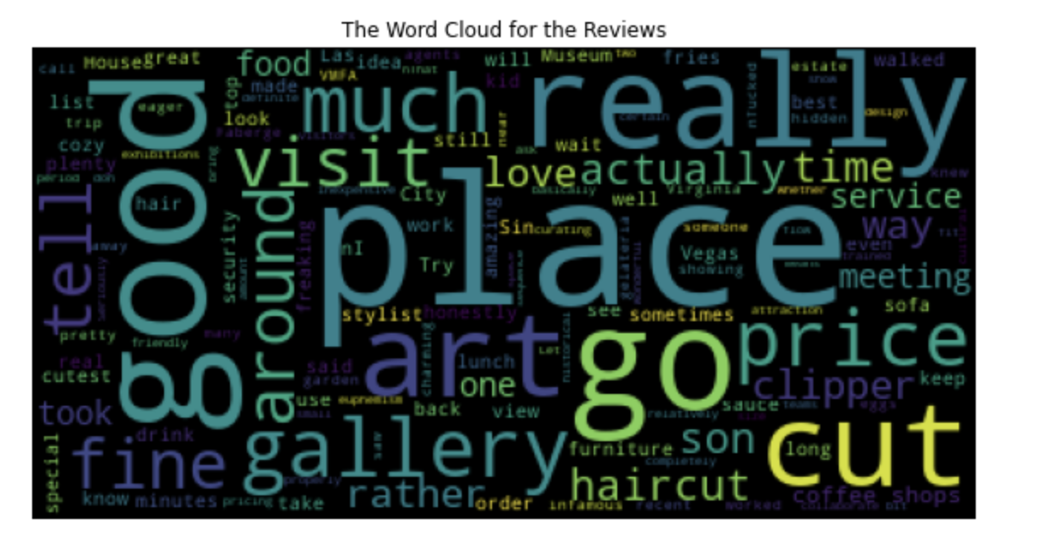
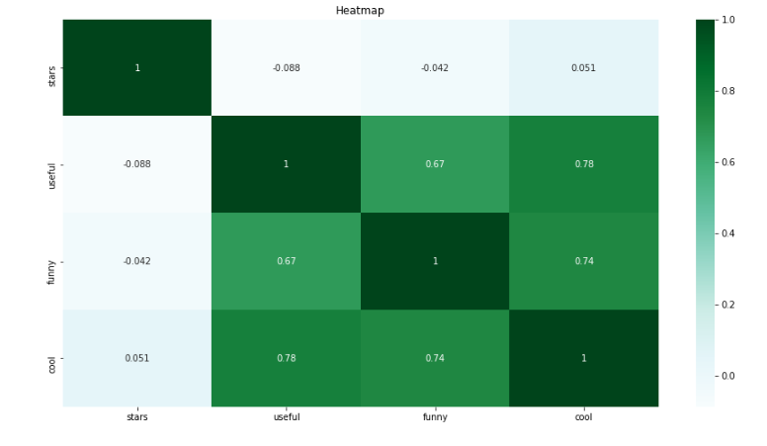
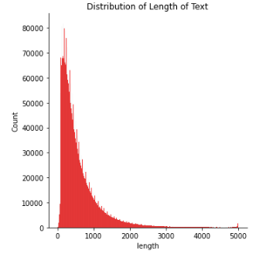
Exploratory data analysis
An important part of the data analysis which provided a lot of data insights with regard to the project.
Packages Used : Seaborn, Matplotlib
Word Cloud was developed for the reviews which gave an insight about the buzzing words which are mostly commonly used by the people.
Thereby which gives an opportunity to improve the performance of their businesses.
A couple of reasons were identified from the reviews which prove to be an important aspect in running the business.

Slide 10
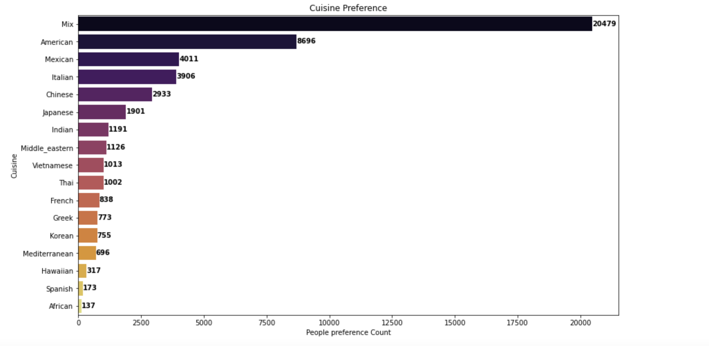
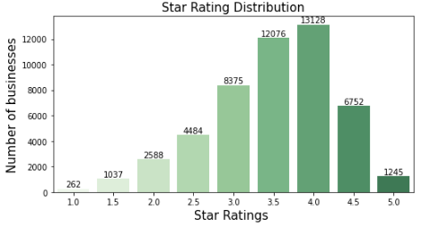
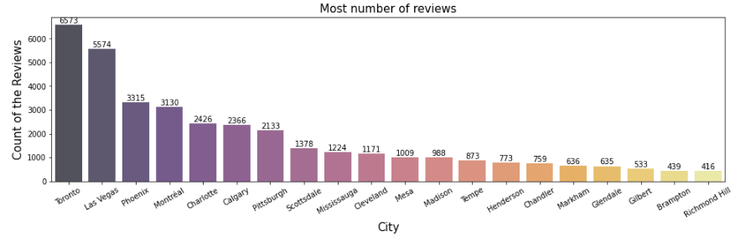
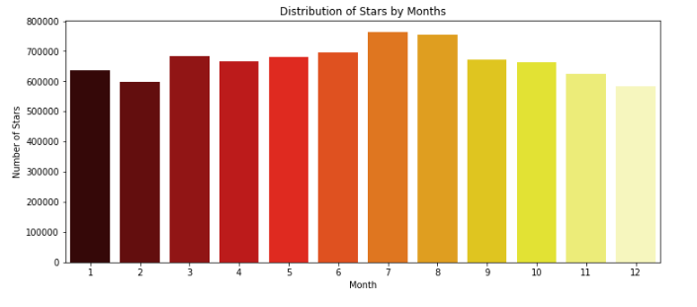
Exploratory data analysis
Majority of the reviews written were well within the 1000-word mark as per distribution seen in our analysis.
Cuisines are an important preference for a business to run.
American, Mexican, Italian, Chinese occupy the major preferences chosen by the people.
An addition to the above-mentioned cuisines can improve their businesses.
Lastly Majority of the people prefer a Mix of offerings offered by the restaurant.

Slide 11

Machine Learning
Packages used : Scikit-Learn
Classification of the reviews through the rating.
Target Column – Stars.
Algorithms used Support Vector Machine , Decision Tree and Random Forest.
Being Computationally expensive a sample of the data had been taken into consideration.
Grid Search was used to identify the best parameters for the algorithms.

Slide 12
Machine Learning Process
Sampling of Data
Division of Star rating into Classes
Count Vectorization
Splitting into Train and Test
Application of Algorithm

Slide 13

Model Performance
Each of the above models classify the reviews into positive and negative.
As a Test, a review has been chosen of the text column.
There by using the model the reviews have been classified into positive and negative.
Due to lack of computational power, the operations could not perform on the entire dataset.
Confusion Matrix and Classification Reports for each of the algorithms have been performed.

Slide 14
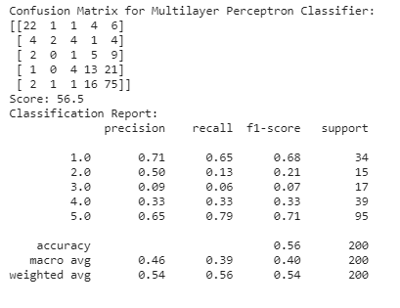
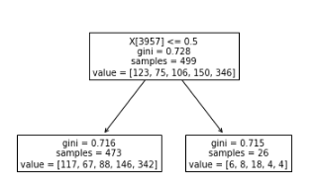
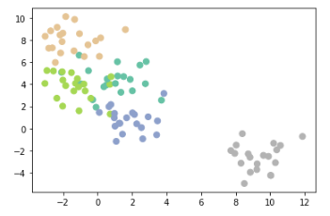
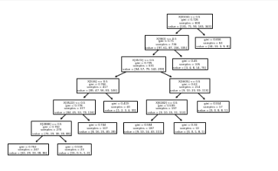
Recommender application
Join Reviews and Categories
1
Clean Text using import re
2
Word Tokenization
3
Delete Stop Words
4
Count Vectorization
5
Define Bot function
Process Flow
Multilayer Perceptron Classifier
SVM
Decision Tree
Random Forest

Slide 15
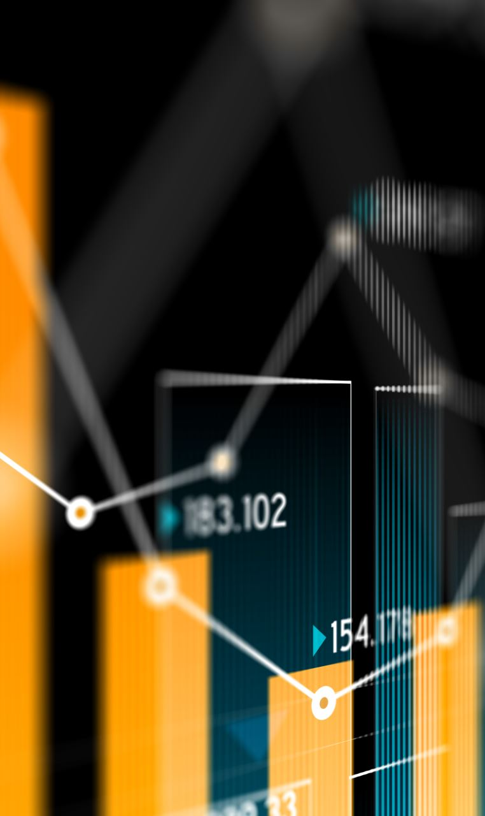
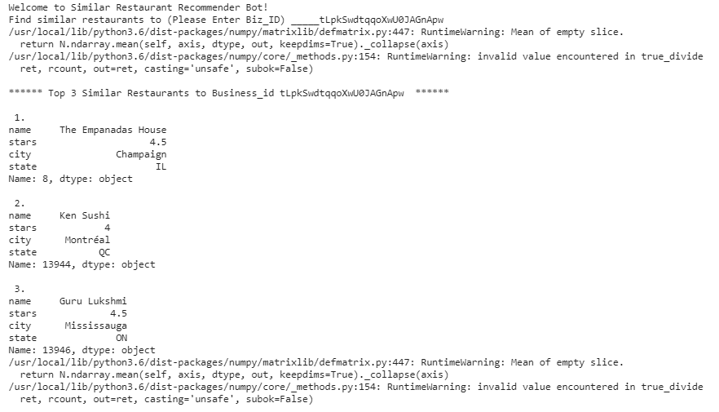
Recommender application
Recommendation provides a huge add on to their business value and reduces the gap between the customer interface and application.
Recommender uses most common features among the business places.
The Recommendation application uses business ID , categories, name, star rating, city and state as the closest match.
Personalization, Customer Satisfaction, Revenue , Product Reports are key parameters which can improve the business value of the organization.

Slide 16
Thank you !

